Slide 1
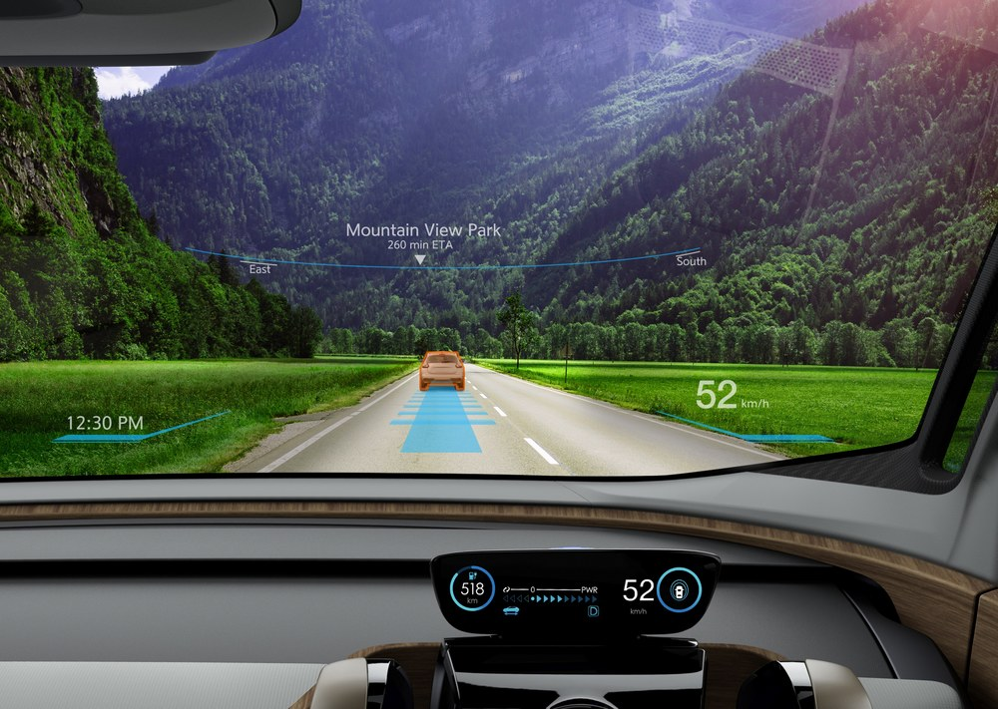
Self driving car using deep learning Giving Cars The Power To See, Think, And Learn
Dhanshri More
NUID: 001619840

Slide 2
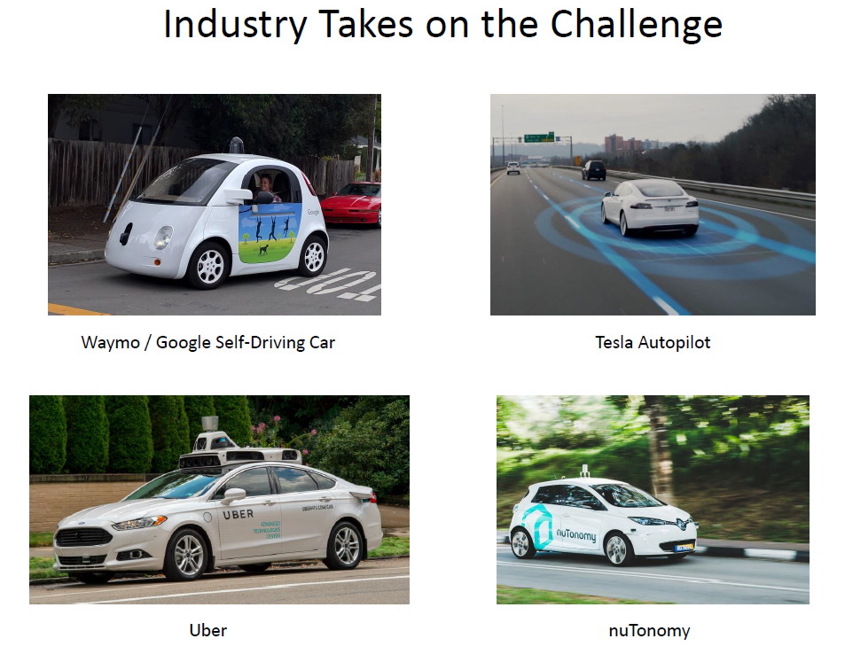

Slide 3
Objective
To train convolutional neural network (CNN) for self driving cars, to map raw pixels from a single front-facing camera directly to steering commands

Slide 4
Description:
CNN have revolutionized pattern recognition. This project aim CNNs to go beyond pattern recognition and learn entire processing pipeline needed to steer an automobile.

Slide 5
Dataset:
data was collected by driving on a wide variety of roads and in a diverse set of lighting and weather conditions
Data was collected in clear, cloudy, foggy, snowy, and rainy weather, both day and night.
In some instances, the sun was low in the sky, resulting in glare reflecting from the road surface and scattering from the windshield.

Slide 6
Data Extraction:
All sensor data including imagery and steering wheel angles is provided in the ROSbag format. To playback this data, you will need to install ROS on a Ubuntu Linux platform.
Steps to get data in JPG/ PNG format:
Download VMware workstation
Install Ubuntu 16.04 on VMware workstation
Install Docker with this link: https://docs.docker.com/engine/installation/linux/ubuntulinux/
Download rwightman’s repository to VirtualBox
Download the torrents to your local machine
Run rwightman’s reader

Slide 7
Algorithms:
Using deep learning algorithm (CNN):
Train convolutional neural net to process visual data from front camera mounted on vehicle. Perform hyper parameter tuning to get best model that gives steering angle for self driving car

Slide 8
Framework:
Hardware:
Ubuntu 16.04 64bit
AWS g2.2xlarge: for graphics-intensive applications
Software and library:
Coding language: python
Deep learning library: Tensorflow, Keras

Slide 9
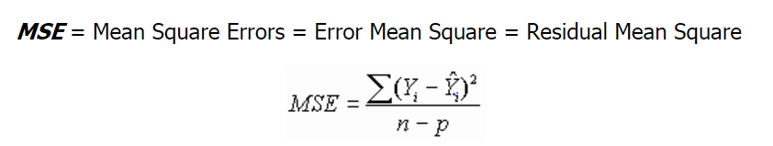
Evaluation Technique: 1. Model evaluation technique
Split dataset into training validation and test dataset
Train model on training dataset and validate against validation dataset to fine-tune model and avoid overfitting
Score model against test dataset
The MSE use to represent the mean squared difference between predicted values and observed values.

Slide 10

Evaluation Technique: 2. Simulation or on-road test
Goal of test is to estimate what percentage of the time the network could drive the car (autonomy)
The metric is determined by counting simulated human interventions
interventions occur when the simulated vehicle departs from the center line by more than one meter.
We assume that in real life an actual intervention would require a total of six seconds: this is the time required for a human to retake control of the vehicle, re-center it, and then restart the self-steering mode

Slide 11
Outcomes:
Develop deep learning technique to predict steer wheel angle to automate driving for self-driving cars
Simulate self driving environment to check how well AI works

Slide 12
References:
https://images.nvidia.com/content/tegra/automotive/images/2016/solutions/pdf/end-to-end-dl-using-px.pdf
http://www.nvidia.com/object/drive-px.html
https://arxiv.org/abs/1412.6980v8
https://keras.io/preprocessing/image/
http://sentiment-mining.blogspot.com/2015/08/the-difference-of-activation-function.html
https://blog.keras.io/building-powerful-image-classification-models-using-very-little-data.html
https://medium.com/udacity/challenge-2-using-deep-learning-to-predict-steering-angles-f42004a36ff3#.2x614nbkt
https://aws.amazon.com/marketplace/pp/B01M0AXXQB#product-description

Slide 13
Thank you!

